Slide 1
Algorithms Lecture 3
Module Leader : Dr. Mostafa Salama
Module Code: Analysis of Algorithms
Module Code: 16CSCI01I
Module Aim:
Analyse the amount of resources needed to solve a given computational problem.
Compare the efficiency of using different algorithms in addressing and solving the problem.
Module Content:
Principles of Algorithm Analysis [Brute Force algorithms]
Greedy Algorithms.
Divide and Conquer Algorithms.
Dynamic Programming Algorithms.
Genetic algorithms
Module Evaluation:
Assignment :20%, deliver in Sunday week 9
Class Test :30%, on week 10
Final Exam :50%
Lecture notes : 2

Slide 2
Divide and Conquer [Definitions]
Divide-and conquer is a general algorithm design paradigm:
Divide: divide the input data S in two disjoint subsets S1 and S2
Recursive call: solve the sub-problems associated with S1 and S2. The recurrence continues until the base case which is of size 0 or 1.
Conquer: combine the solutions for S1 and S2 into a solution for S
Example of D&C:
MergeSort Algorithm
QuickSort Algorithm

Slide 3
D&C [Merge Sort]
Merge-sort algorithm sorts a sequence S with n elements. It consists of three steps:
Divide the sequence into two subsequences,
Recursive call on each subsequence until subsequences are of only one element, and
Merging the subsequences until merged to a sorted sequence C of original sequence S:
Algorithm mergeSorF(S, C) //The function complexity is represented by F(n)
Input sequence S with n //elements, comparator C
Output sequence S sorted //according to C
If S.size() > 1
// Divide: partition S into two sequences S₁ and S₂ of about n/2
// elements each. The complexity of this step constant c since it is only
// partition array into two halves.
(S₁, S₂) ← partition(S, n/2)
// Recur: recursively sort S₁ and S₂. The complexity of this recursive
// step is constant c since it is only calling itself. The complexity of both
// calls is represented 2*F(n/2) since size of each of S₁ and S₂ is n/2.
mergeSorF(S₁, C)
mergeSorF(S₂, C)
// Conquer: merge S₁ and S₂ into a unique sorted sequence. The
// complexity of this step O(n) according the merging algorithm (merge).
S ← merge(S₁, S₂)

Slide 4
D&C [Merge Sort]
The merge algorithm combine two array L and R in a single array A. The complexity of this algorithm is n, such that n = n₁+n₂:
Algorithm merge(L, R)
n₁ = length of array L
n₂ = length of array R
Create array A of length [n₁ + n₂]
i=0, j=0, k=0
while i < n₁ && j < n₂
if L[i] < R[j]
A[k++] ← L[i++]
else
A[k++] ← R[j++]
while i < n₁
A[k++] ← L[i++]
while j < n₂
A[k++] ← R[j++]
Return A
i=0
i=1
i=2
i=3
j=0
j=1
j=2
j=3
L
3
5
7
9
R
2
4
6
8
i ← 0 to n₁-1
j ← 0 to n₂-1
L[i] ≥ R[j] ➔ A[k=0]=R[j=0]
k=0
k=1
k=2
k=3
k=4
k=5
k=6
k=7
A
2
k ← 0 to n₁+n₂

Slide 5
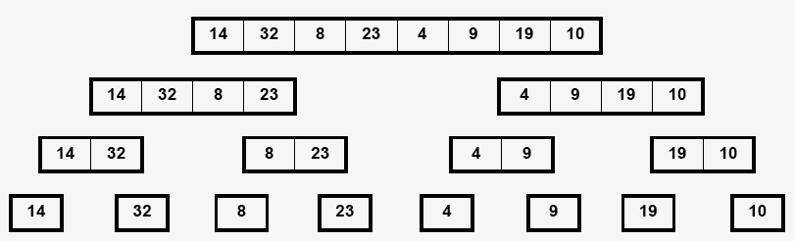
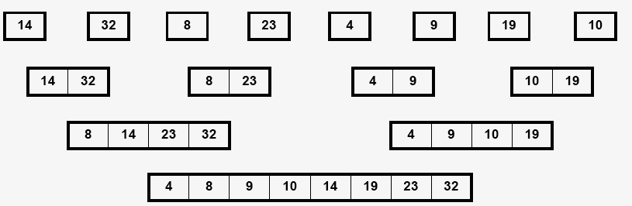








D&C [Merge Sort Analysis]
A recursion tree
Input S
2⁰*c*$\frac{n}{2^{0}}=cn$
2¹*c*$\frac{n}{2^{1}}=cn$
(divide)
O(log n) steps
2²*c*$\frac{n}{2^{2}}=cn$
How much work at every step?
2^{x}*c*$\frac{n}{2^{x}}=cn$
Such that n = 2^{x}
So x = log n = # of steps
O(n) sub-problems
Number of steps :
n*log₂n
2^{x}*c*$\frac{n}{2^{x}}=cn$
(conquer)
2²*c*$\frac{n}{2^{2}}=cn$
O(log n) steps
How much work at every step?
2¹*c*$\frac{n}{2^{1}}=cn$
2⁰*c*$\frac{n}{2^{0}}=cn$
Output C
Number of steps :
n*log₂n
The Total Number of steps of mergeSort is
2*n*log₂n of complexity O(n log₂n)

Slide 6
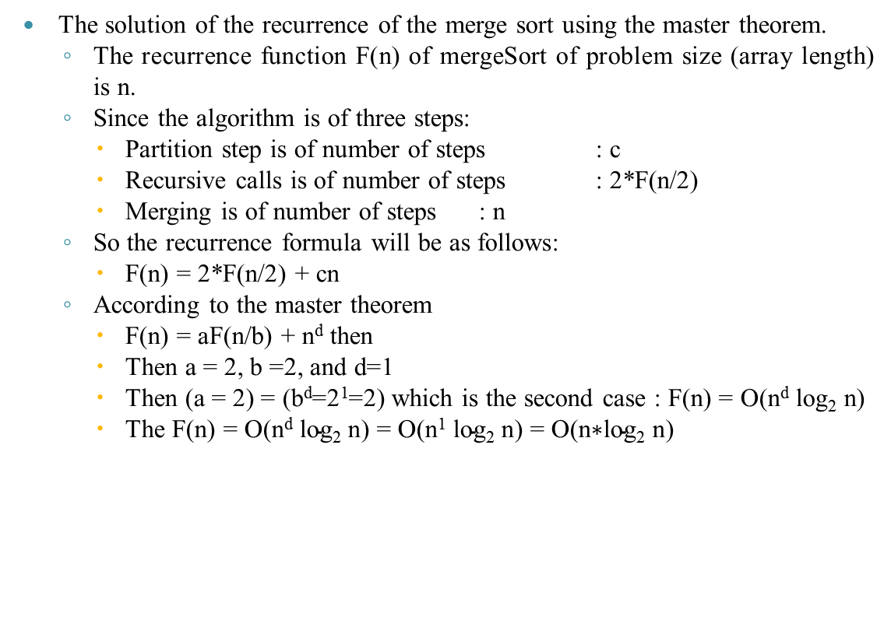
D&C [Merge Sort Analysis]
The solution of the recurrence of the merge sort using the master theorem.
The recurrence function F(n) of mergeSort of problem size (array length) is n.
Since the algorithm is of three steps:
Partition step is of number of steps : c
Recursive calls is of number of steps : 2*F(n/2)
Merging is of number of steps : n
So the recurrence formula will be as follows:
F(n) = 2*F(n/2) + cn
According to the master theorem
F(n) = aF(n/b) + n^{d} then
Then a = 2, b =2, and d=1
Then (a = 2) = (b^{d}=2¹=2) which is the second case : F(n) = O(n^{d} log₂ n)
The F(n) = O($\text{n}\text{d} \text{log}\text{2} \text{n}$) = O($\text{n}\text{1} \text{log}\text{2} \text{n}$) = O($\text{n}\text{∗}\text{log}\text{2} \text{n}$)

Slide 7
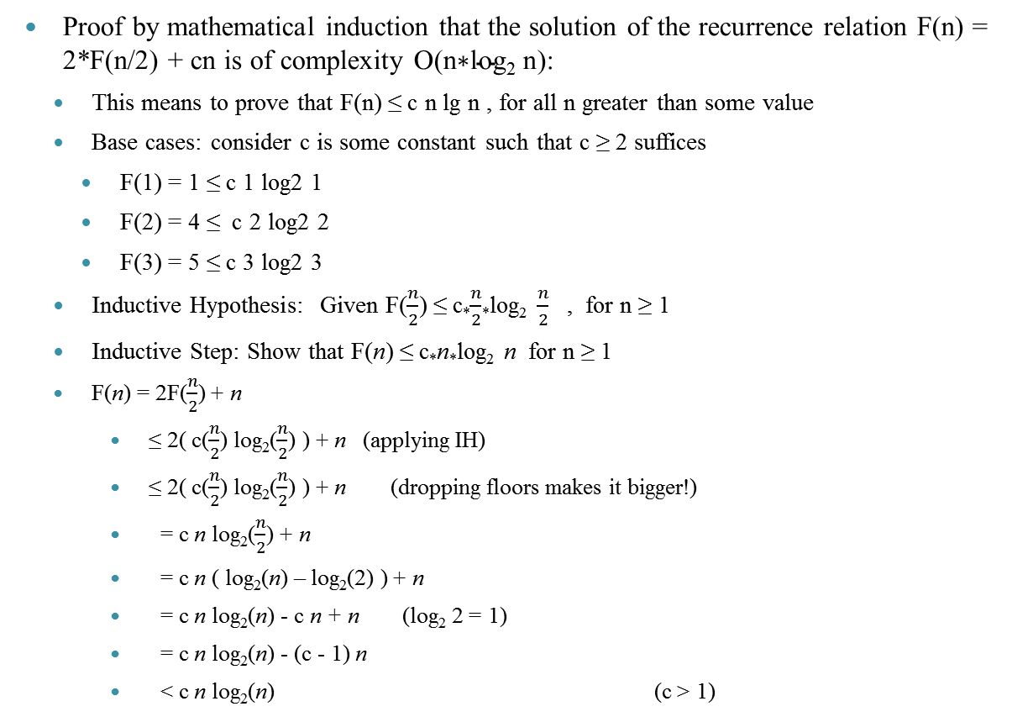
D&C [Merge Sort Analysis]
Proof by mathematical induction that the solution of the recurrence relation F(n) = 2*F(n/2) + cn is of complexity O($\text{n}\text{∗}\text{log}\text{2} \text{n}$):
This means to prove that F(n) ≤ c n lg n , for all n greater than some value
Base cases: consider c is some constant such that c ≥ 2 suffices
F(1) = 1 ≤ c 1 log2 1
F(2) = 4 ≤ c 2 log2 2
F(3) = 5 ≤ c 3 log2 3
Inductive Hypothesis: Given F($\frac{n}{2}$) ≤ c*$\frac{n}{2}$*log₂ $\frac{n}{2}$ , for n ≥ 1
Inductive Step: Show that F(n) ≤ c*n*log₂ n for n ≥ 1
F(n) = 2F($\frac{n}{2}$) + n
≤ 2( c($\frac{n}{2}$) log₂($\frac{n}{2}$) ) + n (applying IH)
≤ 2( c($\frac{n}{2}$) log₂($\frac{n}{2}$) ) + n (dropping floors makes it bigger!)
= c n log₂($\frac{n}{2}$) + n
= c n ( log₂(n) – log₂(2) ) + n
= c n log₂(n) - c n + n (log₂ 2 = 1)
= c n log₂(n) - (c - 1) n
< c n log₂(n) (c > 1)

Slide 8
D&C [Quick Sort]
It turns out that mergeSort, although O(n log₂ n) in its time complexity, has fairly large constants and tends to works on extra memory space (high space complexity).
Quick Sort algorithm has better constants, but has a worst case in O(n²). Fortunately, the worst case is “rare enough”, so that the speed advantages work an overwhelming amount of the time O(n log₂ n) on average case.
q
S[p..r]
88
52
14
31
98
52
25
30
62
23
79
14
88
Partition
98
31
30
≤ 52 ≤
62
25
23
79
S[p..q – 1]
S[q+1..r]
q
14,23,25,30,31
62,79,98,88
52
sort the first half.
sort the second half.
≤ 52
≥ 52

Slide 9
D&C [Quick Sort]
Quick-sort algorithm sorts a sequence S with n elements. It consists of three steps:
Find element p (pivot) that Divide the sequence into two subsequences, all elements in the first sequence is less than p and all elements in the second sequence is larger than p,
Recursive call on each subsequence.
No Combination is required.
Algorithm quickSorF(S, q, r) //The function complexity is represented by F(n); n = r-q
Input sequence S, the first index in S is q and last index is r
Output sequence S sorted
If (q < r) then
// Divide: partition sequence S[q..r] into two subsequences S[q..p-1] and S[p+1..r]. // Each element of S[q..p-1] is ≤ S[p], and each element of S[p+1..r] is ≥ S[p].
//The complexity of this step n
p := partition(S, q, r);
// Recur: recursively sort S[q..p-1] and S[p+1..r].
// In the worst case: both call are represented by F(n-1)=c*(n-1)
// In the best case: both call are represented by 2*F(n/2)=2*c*(n/2)=cn
quickSorF(S, q, p-1)
quickSorF(S, p+1, r)

Slide 10
D&C [Quick Sort]
The partition algorithm Splits the input array S by a pivot. The final position of pivot in the array is dependent on the value at the last index r. The values less than the pivot are swapped before the pivot in S. The for loop in this algorithm will do be n steps, such that n=r-q.
Algorithm partition(S, q, r)
i = q-1
x = S[r]
for j := q to r-1 do
if S[j] ≤ x then
i++;
Swap(S[i], S[j]);
Swap(S[i+1], S[r]);
Return S
q r
initially: 2 5 8 3 9 4 1 7 10 6
j
next iteration: 2 5 8 3 9 4 1 7 10 6
i j
next iteration: 2 5 8 3 9 4 1 7 10 6
i j
next iteration: 2 5 8 3 9 4 1 7 10 6
i j
next iteration: 2 5 3 8 9 4 1 7 10 6
i j
next iteration: 2 5 3 8 9 4 1 7 10 6
i j
next iteration: 2 5 3 4 9 8 1 7 10 6
i j
next iteration: 2 5 3 4 1 8 9 7 10 6
i j
last iteration: 2 5 3 4 1 8 9 7 10 6
i j
before swap: 2 5 3 4 1 8 9 7 10 6
i+1 j=r
After swap: 2 5 3 4 1 6 9 7 10 8
i+1 j=r

Slide 11
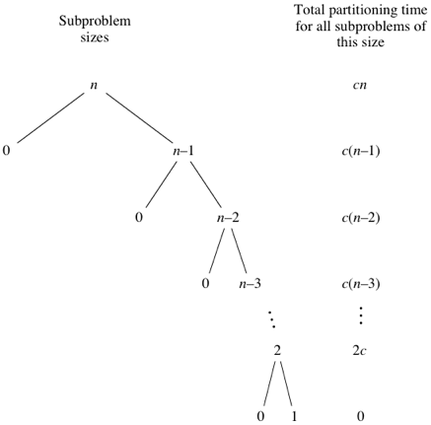
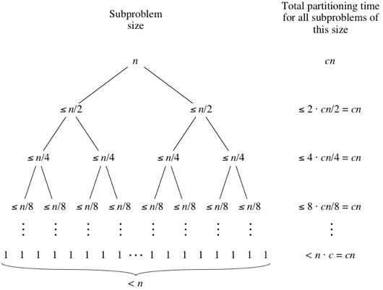
D&C [Quick Sort Analysis]
Worst case has the most unbalanced partitions possible. The sequence of n elements S(n) in this case is partitioned to {pivot, S(n-1)}. So the recursive call on S(n) is of complexity cn, and the recursive call on S(n-1) is of complexity c(n-1), and the recursive call on S(n-2) is of complexity c(n-2), and so on.
The algorithm formula is f(n)=f(n-1) + cn
Best case has partitions are as evenly balanced as possible: their sizes either are equal of size ((n-1)/2) if the number of elements is odd or are within 1 of each other if the number of elements is even. So the recursive call on both partitions is of complexity 2*c*(n/2)=cn, then 2²*c(n/2²)=cn, then 2³*c(n/2³)=cn, and so on.
The algorithm formula is f(n)=2*f(n/2)+cn

Slide 12
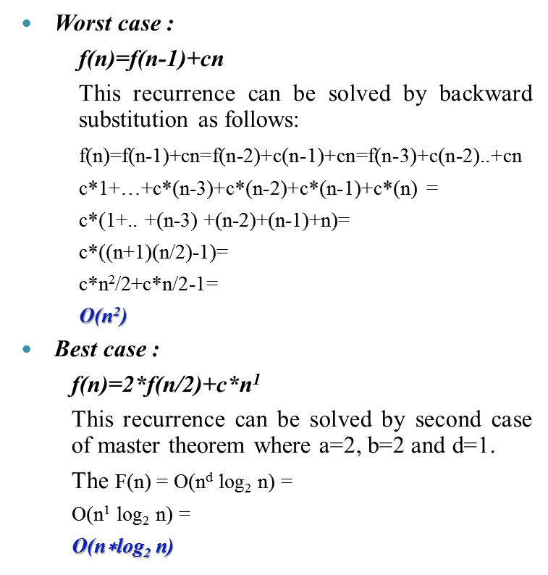
D&C [Quick Sort Analysis]
Worst case :
f(n)=f(n-1)+cn
This recurrence can be solved by backward substitution as follows:
f(n)=f(n-1)+cn=f(n-2)+c(n-1)+cn=f(n-3)+c(n-2)..+cn
c*1+…+c*(n-3)+c*(n-2)+c*(n-1)+c*(n) =
c*(1+.. +(n-3) +(n-2)+(n-1)+n)=
c*((n+1)(n/2)-1)=
c*n²/2+c*n/2-1=
O(n²)
Best case :
f(n)=2*f(n/2)+c*n¹
This recurrence can be solved by second case of master theorem where a=2, b=2 and d=1.
The F(n) = O($\text{n}\text{d} \text{log}\text{2} \text{n}$) =
O($\text{n}\text{1} \text{log}\text{2} \text{n}$) =
O($\text{n}\text{∗}\text{log}\text{2} \text{n}$)

Slide 13
Algorithms Lecture 3
To Do in Lab 3
Implement the MergeSort and QuickSort algorithm using C++
Use a counter to determine the number of steps
Use an execution time calculation
Compare between the two algorithms according to these two values (number of steps and execution time) . Print the values of the two algorithms
Implement threads on C++,
Apply every algorithms in a separate thread.
Check which thread will finish its execution first.

